Slide 1
TEAM NO: 23
JAVA PROJECT EXPO 2026 | FED COURSE PROJECT
Household Water-Usage & Billing Monitor
A Java-based computational system designed for meter tracking, consumption diagnostics, leak flagging, and tiered utility charge calculation.
TEAM MEMBERS
SUPERVISOR
E.V. Vara Prasad (2620030676) • B.V.S. Tejesh (2620080086)
Dr. K. Rajesh Sir

Slide 2



OVERVIEW
Slide 02
Project Summary
Consumption Tracking
Billing Estimation
Leak Detection
Automates raw meter reading calculations to track domestic water usage volume instantly with high precision.
Estimates total financial bills based on unit consumption and local tariff assumptions accurately.
Incorporates occupant data and leak flags to alert households to non-standard usage spikes.

Slide 3
SYSTEM FLOW
Slide 03
Architecture & Pipeline
INPUT
PROCESS
OUTPUT
• Account credentials & details
• Validate input logical boundaries
• Detailed consumption summary
• Previous & current dial values
• Compute net water usage
• Estimated water charge amount
• Number of household occupants
• Calculate bill via tariff rates
• Occupant efficiency review
• Active leak detection status
• Review per-occupant usage ratios
• Active leak warning indicator

Slide 4
COURSE OUTCOME 1
Slide 04
CO1: Basics & Computational Math
Core Algorithm Steps
JAVA PRIMITIVES APPLIED
double previousReading; double currentReading; Scanner scanner = new Scanner(System.in); System.out.printf("Bill: ₹%.2f", bill);
1.
Read previous and current water meter values.
double previousReading; double currentReading; Scanner scanner = new Scanner(System.in); System.out.printf("Bill: ₹%.2f", bill);
2.
Input local unit tariff rate and fixed charges.
3.
Validate bounds (current ≥ previous).
4.
Calculate usage:
usage = current - previous
5.
Compute bill:
Assumed Standard Rate: ₹25 per unit with ₹50 fixed connection charge.
bill = (usage × rate) + fixed

Slide 5


COURSE OUTCOME 2
Slide 05
CO2: Control Flow & Validation
Multi-Month Processing
Decision & Validation Rules
• Sequential multi-month record validation.
• Negative Values: Instantly reject and signal input error message.
• Accumulation of total volume consumption.
• Inverted Dials: Request re-entry if current < previous reading.
• Calculation of rolling monthly averages.
• Valid Readings: Compute usage differential and estimate bill.
• Automatic threshold overrun flags.

Slide 6
COURSE OUTCOME 3
Slide 06
CO3: Arrays & Modular Methods
Array Storage & Historical Records
validateReadings()
Checks logical input bounds and sequence integrity.
Maintains synchronized parallel arrays (months[], usage[], bills[]) to query peak usage periods, compute projected annual expenditures, and lay groundwork for object-oriented persistence.
calculateUsage() & calculateBill()
Computes consumption delta and evaluates cost via tariff rates.

Slide 7
COURSE OUTCOME 4
Slide 07
CO4: Object-Oriented Design
Encapsulated Classes
Polymorphism & Packages
• WaterMeter: Stores previous & current dial stats.
• Billable Interface: Defines standard contracts across tariff models.
• HouseholdAccount: Holds consumer profile and assigned rate structure.
• Subclassing: Custom commercial vs residential rate algorithms.
• Package Organization: Clean separation between model, billing, and reports.
• WaterBill: Encapsulates charge calculation behavior.

Slide 8

COURSE OUTCOME 5
Slide 08
CO5: I/O & Collections
Exception Handling & Storage
Collections & Streams
Guards system state against malformed user inputs and unexpected disk failures using Java exception handling (try-catch). Persists consumption history directly into structured CSV/text logs.
Replaces fixed static arrays with ArrayList for dynamic scaling. Leverages Java Streams to filter high-usage months and perform aggregate summary computations.

Slide 9
COURSE OUTCOME 6
Slide 09
CO6: Integration & QA Testing
1
2
3
4
Capture Data
Validate Delta
Tariff Engine
Export & Summary
Ingest user inputs and meter readings.
Check bounds and compute consumption.
Apply rate structures and surcharges.
Generate final logs and report output.

Slide 10

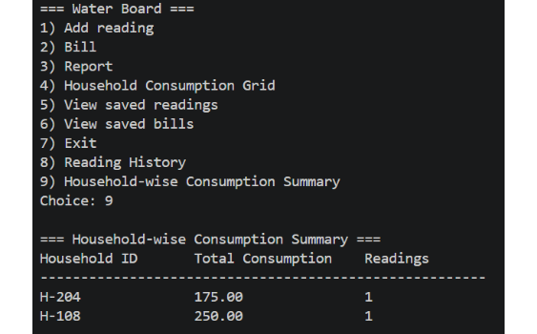
EXECUTION & PROOF
Slide 10
Application Screenshots & Console Output
PROGRAM EXECUTION SUMMARY
=== Water Board === 1) Add reading 2) Bill 3) Report 4) Household Consumption Grid 5) View saved readings 6) View saved bills 7) Exit 8) Reading History 9) Household-wise Consumption Summary Choice: 9 === Household-wise Consumption Summary === Household ID Total Consumption Readings ------------------------------------------- H-204 175.00 1 H-108 250.00 1
Water Board Console Output Screenshot
Real console output from application execution.

Slide 11
SUMMARY
Slide 11
Conclusion & Future Scope
Project Accomplishments
Future Enhancements
• Demonstrates practical Java application for utility monitoring.
• Database persistence layer (MySQL / PostgreSQL).
• Prevents invalid calculations via strict logical validation rules.
• Integration with real-time IoT smart digital water meters.
• Increases leak awareness through occupant context.
• Dynamic local municipal tariff API synchronization.

Slide 12
TEAM NO: 23
End of Presentation
Thank You!
GitHub Repository Link:
https://github.com/Varaprasad0021/KLHB_FED_2026-27_PSPJ_S10_T23_Household-Water-Usage-Billing-Monitor.git

